Slide 1

Gokaraju Rangaraju Institute of Engineering and Technology (Autonomous) Department of Data Science Mini Project Work (CSE(DS))
Review 3: Module Presentation
Batch No - 7
Presented by:
1. Karthik Vaishnav (23241A67F9)
2. Srinish Reddy (23241A67D8)
3. Pranay Teja (23241A67J6)
Under the Guidance of:
Ms. K Kalpana
Assistant Professor

Slide 2
Explainable AI (XAI) Dashboard for Students
‹#›

Slide 3
Introduction
System Concept: An interactive Explainable AI (XAI) learning dashboard that helps students understand how machine learning models make decisions.
Problem Context: Traditional ML tools focus mainly on performance metrics like accuracy, making models appear as black boxes to students.
Core Idea: Integrate model training, visualization, and explanation techniques (SHAP and LIME) into a single educational workbench.
Data Source: Real-world datasets uploaded by students in CSV format, preprocessed automatically for ML model training and explanation.
‹#›

Slide 4
Explanation Method: Provide global explanations (overall feature importance) and local explanations (feature contributions for individual predictions) using SHAP and LIME.
Dashboard Features: Interactive 2D/3D visualizations, decision boundaries, confusion matrix, and what-if scenario simulation for hands-on learning.
ML Models Supported: Support multiple ML models including Logistic Regression, Decision Tree, Random Forest, and SVM with configurable train-test splits.
Expected Impact: Transform ML education from a formula-driven process into a visual, interactive, and explanation-driven learning experience.

Slide 5
Discuss Base paper
Title: “Why Should I Trust You?” Explaining the Predictions of Any Classifier
Authors: Ribeiro, M. T., Singh, S., & Guestrin, C.
(2016)
Journal: Proceedings of the 22nd ACM SIGKDD International Conference, 2016
Core Objective: Introduces LIME — a technique to explain predictions of any black-box ML model by approximating it locally with a simple interpretable model. Forms the basis for local explanations in our XAI Dashboard.

Slide 6
Main Points discussed in papers:
LIME explains individual predictions by approximating the complex model locally using a simple, interpretable surrogate model.
Input perturbations are used to observe how prediction changes, helping identify the most important features for a given prediction.
The method is model-agnostic — applicable to any classifier or regressor — improving transparency, trust, and debugging of ML models.
Experimental results demonstrate that local explanations significantly improve user trust and understanding compared to black-box model outputs.

Slide 7
Comparison with Base paper
Base Paper Methodology | Our Improvement
Provides local, model-agnostic explanations for individual predictions using input perturbations. | Integrate LIME into a full interactive dashboard with both local and global explanations alongside model training and visualization.
SHAP (Lundberg & Lee, 2017) provides unified feature attribution but is primarily a library, not an educational tool. | Use SHAP within a student-friendly dashboard providing visual and conceptual explanations for both global and local feature importance.
explAIner (Spinner et al., 2019) is a visual analytics framework for XAI, but research-oriented and complex for students. | Adapt similar visual analytics ideas into a simplified, student-focused learning dashboard with what-if analysis and model comparison.
Molnar (2019) covers interpretability methods comprehensively but is a reference guide with no interactive platform. | Combine multiple interpretability techniques (SHAP, LIME, PDP, Feature Importance) into a single interactive learning system.

Slide 8
Literature review:
The literature review shows that Explainable AI (XAI) has become a critical area of research due to the black-box nature of modern ML models. Foundational works such as LIME and SHAP have established widely accepted methods for local and global explanations. Multiple surveys highlight that visualization plays a key role in making explanations understandable to users. Visual analytics frameworks demonstrate that combining interactive visualizations with explanation techniques significantly improves user trust and conceptual understanding. The literature also emphasizes that interpretability is a human-centered problem. Recent studies in educational contexts show that explainable dashboards help non-expert users understand and trust ML systems. Most existing XAI tools are designed for researchers, creating a clear gap for a simplified, student-friendly XAI dashboard that this project addresses.
‹#›

Slide 9
Literature Review Summary
Source | Research Objective or Research Question | Methodology | Key Findings | Relevance to Project | Techniques | Accuracy & Performance Measures | Advantages | Disadvantages
Ribeiro et al. (2016) – LIME | Explain individual model predictions in a model-agnostic way | Local surrogate models using input perturbations | Local linear explanations improve trust and model debugging | Supports local explanation module in XAI dashboard | LIME, surrogate models | Focus on explanation fidelity, not model accuracy | Model-agnostic, easy to apply to any classifier | Local instability; approximation errors possible
Lundberg & Lee (2017) – SHAP | Unified framework for feature attribution (global and local) | Game-theoretic Shapley values for feature attribution | Consistent and theoretically sound feature explanations | Core method for global and local explanations in dashboard | SHAP, Shapley values | Explanation consistency; strong theoretical guarantees | Strong theoretical guarantees; both global and local views | Computationally expensive for large datasets

Slide 10
Source | Research Objective or Research Question | Methodology | Key Findings | Relevance to Project | Techniques | Accuracy & Performance Measures | Advantages | Disadvantages
Doshi-Velez & Kim (2017) | Define rigorous evaluation framework for interpretable ML | Conceptual and evaluation frameworks for interpretability | Interpretability must be task and user dependent | Guides educational design of explanations in dashboard | Conceptual XAI frameworks | Human-centered interpretability focus | Emphasizes user-need-driven explanation design | Lacks practical system implementation
Molnar (2019) – Interpretable ML Book | Provide practical guide to interpretable machine learning | Survey of PDP, Feature Importance, SHAP, LIME with examples | Visualization is critical for human understanding of models | Justifies multi-method dashboard combining several XAI tools | PDP, SHAP, LIME, Feature Importance | Indirect focus; comprehensive coverage | Comprehensive and accessible reference | Not an interactive or integrated system
Spinner et al. (2019) – explAIner | Integrate XAI into a visual analytics workflow | Interactive visual ML framework with model comparison | Visual tools improve trust and model diagnosis | Supports interactive dashboard design for our project | Visual XAI, Feature Importance | Strong visual analytics capability | Improves user trust and model understanding | Research-oriented; complex for students

Slide 11
Source | Research Objective or Research Question | Methodology | Key Findings | Relevance to Project | Techniques | Accuracy & Performance Measures | Advantages | Disadvantages
Chan et al. (2020) – MELODY | Aggregate local explanations into global model summaries | Information-theoretic aggregation of local explanations | Better global understanding from local explanations | Supports global vs local explanation views in dashboard | Aggregated local explanations | Holistic model understanding | Combines local into global for deeper understanding | Limited direct interactivity
Kovalerchuk et al. (2020) – Visual XAI Survey | Survey of visual and granular explainability methods | Visualization improves human interpretability of models | Visual methods enable broader human understanding of ML | Supports advanced visualizations in dashboard design | Visual XAI, Granular Methods | Broad coverage of visual techniques | Wide coverage of explainability visualization methods | No system implementation provided
XAI in Education (2022) – Survey | Study role of XAI in educational analytics systems | Survey and conceptual models for educational XAI | Explainability improves student learning and trust | Supports educational goal of the XAI dashboard | Educational XAI frameworks | Not accuracy-centric; education-focused | Directly applicable to student-centered learning | Limited to learning analytics context only

Slide 12
Source | Research Objective or Research Question | Methodology | Key Findings | Relevance to Project | Techniques | Accuracy & Performance Measures | Advantages | Disadvantages
Khelifi et al. (2024) – EX-LAD | Explainable dashboards for learning analytics | Dashboard-based XAI for educational prediction systems | Explainability improves interpretability in education | Supports dashboard concept for multiple ML models | Educational XAI, Dashboard | Applicable to diverse educational data | Strong applicability to student learning context | Focused on educational prediction only
Gunasekara & Saarela (2024)– Review of XAI in Education | Review explainability techniques in educational ML systems | Review paper surveying XAI methods in education | Converts reviewed concepts into practical interactive workbench | Supports practical implementation of reviewed XAI concepts | Survey of XAI methods | Broad review coverage | Comprehensive XAI method coverage for education | No practical tool provided

Slide 13
Research Gaps
Most existing XAI work focuses on individual explanation methods (SHAP or LIME alone) rather than integrated, end-to-end learning platforms.
Existing XAI tools are designed for researchers or industry users, making them complex and unsuitable for students.
No unified system combines data preprocessing, model training, evaluation, and explainability in a single interactive environment.
Visual analytics XAI systems exist but are research-oriented and difficult to use in educational settings.
Limited work on student-friendly, interactive XAI dashboards that support intuitive learning and conceptual understanding of ML models.
‹#›

Slide 14
Problem statement
Despite the rapid adoption of machine learning, most learning platforms focus mainly on model accuracy, offering little insight into how and why models make decisions. This lack of explainability causes ML models to appear as black boxes, making it difficult for students to connect theory with real-world behavior. Although XAI methods like SHAP and LIME exist, they are rarely integrated into interactive, student-friendly learning environments. This project proposes an integrated XAI dashboard that combines model training, evaluation, visualization, and explanation to improve conceptual understanding and hands-on ML learning for students.
‹#›

Slide 15
Objectives
Develop an interactive XAI learning dashboard that allows students to upload datasets, train ML models, and explore explanations through a unified interface.
Integrate both SHAP and LIME explanation techniques to provide global feature importance and local prediction explanations in a student-friendly manner.
Support multiple ML models including Logistic Regression, Decision Tree, Random Forest, and SVM with configurable preprocessing and train-test splits.
Provide interactive visualizations including 2D/3D feature plots, decision boundaries, confusion matrix, and what-if scenario simulation.
Evaluate the effectiveness of the XAI dashboard in improving student conceptual understanding of ML model behavior and feature contributions.

Slide 16
Proposed Solution
Our proposed system is an interactive Explainable AI (XAI) learning dashboard designed to help students understand how machine learning models make decisions. The system allows users to upload real-world datasets in CSV format and performs automatic preprocessing including handling missing values, encoding categorical variables, and feature scaling. Students can then select from multiple ML models such as Logistic Regression, Decision Tree, Random Forest, and SVM, and configure train-test splits to observe how these choices affect performance. A key component is the XAI layer, which integrates SHAP and LIME along with model-based interpretability methods to provide both global explanations (overall feature importance) and local explanations (feature contributions for individual predictions). The interactive dashboard presents evaluation metrics such as accuracy, precision, recall, F1-score, and confusion matrix in a student-friendly manner. Advanced visualizations including 2D/3D plots and decision boundaries are included to enhance conceptual understanding. The overall goal is to transform ML education from a formula-driven process into a visual, interactive, and explanation-driven learning experience.

Slide 17
Framework Overview
Data Input Layer
Students upload CSV datasets via the dashboard interface
Automatic preprocessing: missing values, encoding, scaling
Model Training Layer
Select ML model (Logistic Regression, Decision Tree, Random Forest, SVM)
Configure train-test split and train the selected model
Explanation Layer
SHAP for global feature importance and local attributions
Novelty with respect to Base Paper
Integrated XAI Platform: Unlike base papers that offer only standalone LIME or SHAP, our dashboard integrates both methods with full model training in one platform.
Student-Centered Design: The base papers target researchers; our dashboard is simplified for students with guided workflows and friendly visualizations.
What-If Scenario Analysis: Students can interactively change feature values to observe how predictions change, a feature not present in the base XAI libraries.

Slide 18
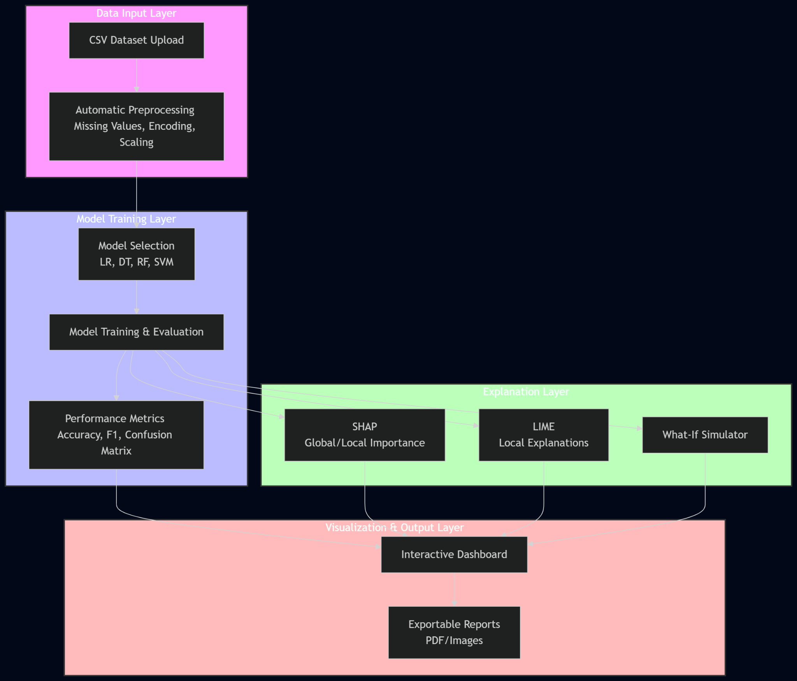
Architecture Diagram
Data Input Layer
Students upload CSV datasets; the system performs automatic preprocessing and forwards clean data for model training.
Model Training Layer
User selects ML model and configures parameters; the system trains and evaluates the model, producing accuracy and performance metrics.
Explanation Layer
SHAP and LIME generate global and local explanations; feature importance and prediction contributions are computed.
Visualization and Output Layer
Interactive dashboard displays metrics, 2D/3D plots, decision boundaries, and what-if simulation results for student exploration.

Slide 19
Methodology / Algorithms
Data Upload and Preprocessing
Students upload real-world CSV datasets. The system performs automatic preprocessing including handling missing values, encoding categorical variables, and feature scaling. Feature selection is also supported, allowing users to observe how input choices affect model performance.
ML Model Training
Students select from Logistic Regression, Decision Tree, Random Forest, or SVM. The system trains the chosen model on the preprocessed data and evaluates it using accuracy, precision, recall, F1-score, and confusion matrix.
XAI Explanation – SHAP and LIME
SHAP generates global feature importance across the full dataset and local Shapley-value attributions for individual predictions. LIME approximates the model locally using perturbed samples to identify which features drive each specific prediction.
Visualization and What-If Analysis
The dashboard renders 2D/3D feature plots, decision boundaries, and SHAP/LIME charts. Students can modify input feature values interactively and observe how the model's prediction changes, enabling deeper conceptual understanding.

Slide 20
Software and Hardware Requirements
SOFTWARE | HARDWARE
Python – Core language for data processing, ML model training, XAI computation, and dashboard logic. ML Libraries – Scikit-learn (ML models), SHAP (feature attribution), LIME (local explanations). Streamlit / Flask – For building the interactive web-based student dashboard and UI. Pandas & NumPy – For data preprocessing, feature engineering, and matrix operations. Matplotlib / Plotly – For 2D/3D visualizations, decision boundary plots, and SHAP/LIME charts. Jupyter Notebook – For model development, experimentation, and documentation. Windows / Linux / macOS – Cross-platform support for dashboard deployment and student use. | Minimum 8GB RAM System / Laptop – Primary hardware for running the dashboard, training models, and displaying visualizations. Web Browser – For accessing the Streamlit/Flask-based interactive XAI dashboard interface. Dataset Storage (CSV Files) – Real-world CSV datasets uploaded by students for training and explanation. GPU (Optional) – For accelerating model training on larger datasets if available. Internet Connection – For accessing open datasets and library documentation during sessions. Personal Computer – Required hardware specification for smooth dashboard and model training performance.

Slide 21
Datasets Details
Typical Dataset Attributes
Numerical Features:
Age
Income
Score
Count
Rate
Value
Categorical Features:
Gender
Class / Label
Category
Status
Type
Iris Dataset (UCI Machine Learning Repository)
150 samples, 4 features, 3 classes Used for classification demonstration and explanation
Titanic Dataset (Kaggle)
891 training samples, 12 features
Usage in Project: Used for binary classification and feature importance exploration.

Slide 22
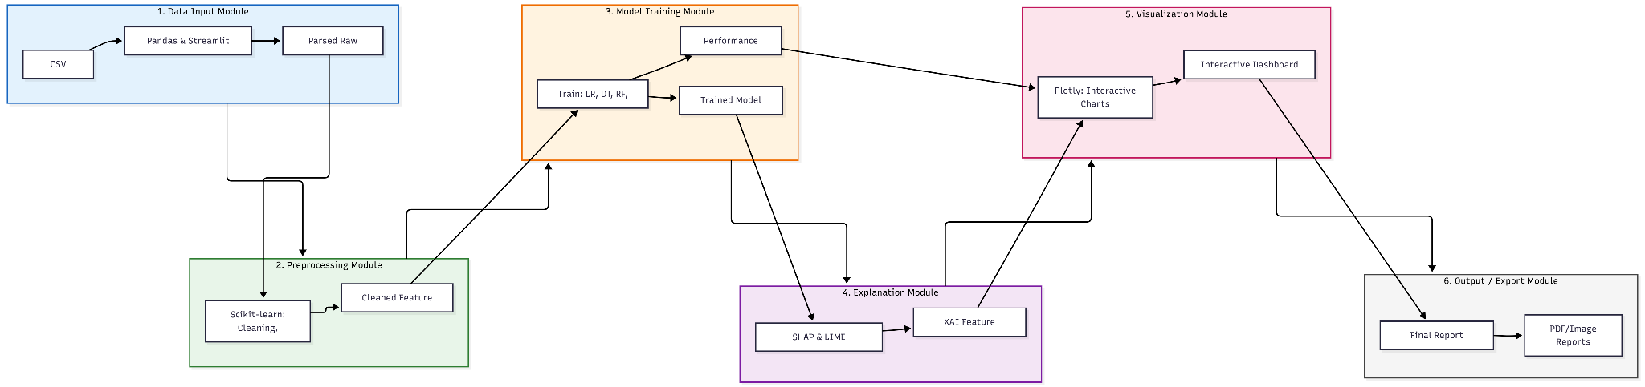
Module connectivity diagram

Slide 23
Data flow diagram
Data collection starts in the Data Input module, where the student uploads a CSV dataset through the dashboard interface.
The collected raw data is sent to the Preprocessing module, where missing values are handled, categorical variables are encoded, and features are scaled.
The processed data is stored and passed to the Model Training module, where the selected ML model (Logistic Regression, Decision Tree, Random Forest, or SVM) is trained.
The trained models generate predictions for new incoming data, which are forwarded to the Explanation module.
In the explanation stage, SHAP and LIME compute global and local feature attributions.
If abnormal behavior is detected, the results are sent to the Output module.
The output module updates the dashboard, stores logs, and sends real‑time alerts to notify the user.

Slide 24
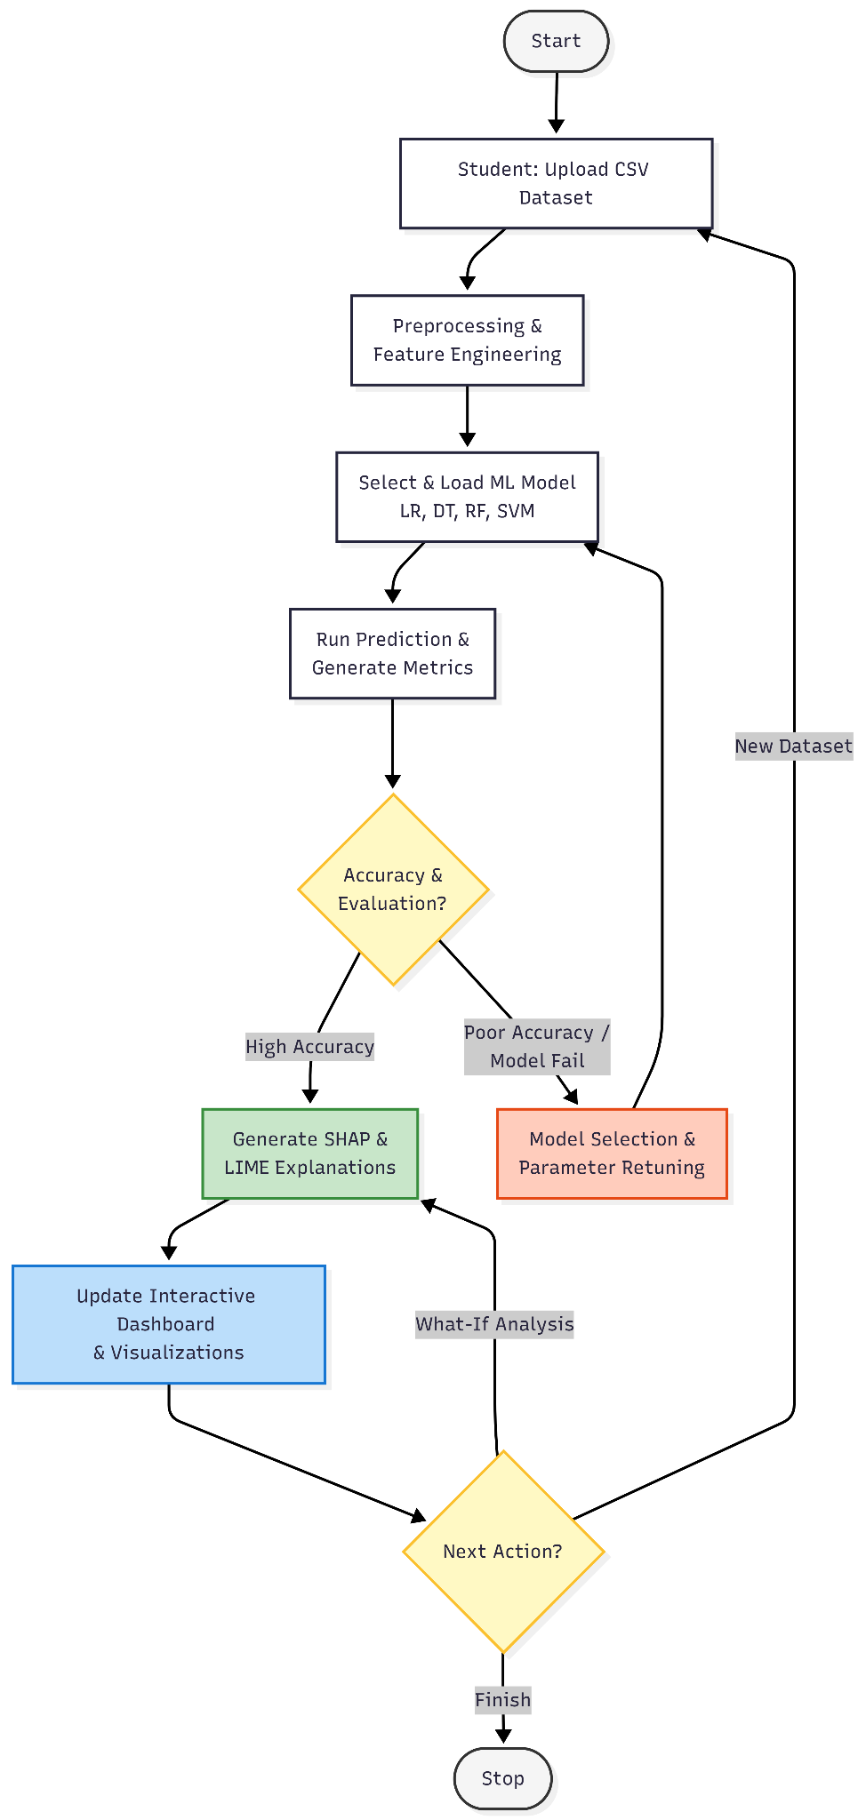
Control flow diagram
System starts with data upload, where the student uploads a CSV dataset via the dashboard.
The collected data goes to preprocessing and feature engineering, where missing values are handled, encoding and scaling are applied.
The processed data is passed to the model, where the selected ML model is trained on the processed data.
The model performs prediction and evaluation on the new incoming data.
The predicted values are compared with actual values in the explanation stage.
If the result is normal, the system displayed on the dashboard for student exploration.
If an anomaly is detected, the system re-runs prediction and updates the explanation interactively.
If the evaluation shows poor accuracy or model failure, the system goes to model selection and retraining, choose different parameters, and retrain.
The process repeats continuously for the different datasets or models, making the dashboard a flexible learning tool.

Slide 25
Modules description
Module | Inputs | Processing Logic (Algorithms / Methods / Tools) | Output / Exports | Interdependence | Libraries / Frameworks
Data Input | Student-uploaded CSV dataset file | File upload via dashboard UI; automatic parsing and validation of CSV structure | Parsed raw dataset | Sends raw dataset to Preprocessing module | Python, Pandas, Streamlit/Flask
Preprocessing | Raw parsed dataset | Missing value handling, categorical encoding, feature scaling, train-test split | Cleaned and scaled feature matrix | Receives from Data Input, sends to Model Training module | Python, Pandas, NumPy, Scikit-learn
Model Training | Cleaned feature matrix, user-selected model and parameters | Train selected ML model (Logistic Regression, Decision Tree, Random Forest, SVM); evaluate performance | Trained model object, accuracy, precision, recall, F1-score, confusion matrix | Receives from Preprocessing, sends trained model to Explanation module | Scikit-learn, Joblib, Python
Explanation | Trained model, full dataset, individual prediction instances | Run SHAP for global feature importance and local attributions; run LIME for individual prediction explanations | SHAP values, LIME explanations, feature importance rankings | Receives from Model Training, sends to Visualization module | SHAP, LIME, NumPy, Python

Slide 26
1. Data Input Module
Inputs:
Student-uploaded CSV dataset file
User-selected ML model and configuration parameters
Processing Logic:
Dashboard receives CSV upload from student
System validates file structure and parses data
Dataset preview is displayed for student review
Outputs:
Parsed raw dataset ready for preprocessing
Interdependence: Sends parsed dataset to Preprocessing module
Tools / Libraries: Python, Pandas, Streamlit / Flask, CSV parser
2. Preprocessing Module
Inputs:
Parsed raw CSV dataset
User-defined feature selection and train-test split ratio
Processing Logic:
Handle missing values (imputation or removal)
Encode categorical variables (label/one-hot encoding)
Scale numerical features (StandardScaler / MinMaxScaler)
Outputs:
Cleaned and scaled feature matrix
Train and test split arrays ready for model training
Interdependence: Receives from Data Input → Sends to Model Training module
Tools / Libraries: Python, Pandas, NumPy, Scikit-learn

Slide 27
3. Model Training Module
Inputs:
Cleaned feature matrix, user-selected model type, and train-test split
Processing Logic:
Train chosen ML model: Logistic Regression, Decision Tree, Random Forest, or SVM
Evaluate on test set: accuracy, precision, recall, F1-score, confusion matrix
Save trained model object for explanation and what-if use
Outputs:
Trained ML model object
Accuracy, Precision, Recall, F1-score, Confusion Matrix
Interdependence: Receives from Preprocessing → Sends trained model to Explanation module
Tools / Libraries:
Scikit-learn,Joblib, Python
4. Explanation Module
Inputs:
Trained model object
Full dataset and individual prediction instances
Processing Logic:
Run SHAP: compute global feature importance and local Shapley attributions
Run LIME: perturb input and generate local explanation for each prediction
Outputs:
SHAP global importance chart, SHAP local attribution values
LIME explanation bar chart for individual predictions
Interdependence: Receives from Model Training → Sends explanations to Visualization module
Tools / Libraries: SHAP, LIME, NumPy, Python

Slide 28
5. Visualization Module
Inputs:
Model metrics, SHAP values, LIME explanations, user feature inputs
Dataset for 2D/3D plotting and decision boundary rendering
Processing Logic:
Render SHAP summary plots and bar charts
Render LIME local explanation charts
Display confusion matrix, 2D/3D feature plots, decision boundary
Outputs:
Interactive charts rendered on student dashboard
What-if simulator: re-run prediction on modified feature inputs
Interdependence: Receives from Explanation module → Displays to student, sends to Output
Tools / Libraries: Plotly, Matplotlib, Streamlit Python, ReportLab (optional)
6. Output / Export Module
Inputs:
Final dashboard views, student session summary
User-requested export data (charts, metrics)
Processing Logic:
Compile final model performance summary
Allow export of charts and explanation reports as PDF or image
Outputs:
Student-facing dashboard with full explanation and metrics view
Downloadable SHAP/LIME charts and model report
Session log for review and academic submission
Interdependence: Receives from Visualization module
Tools / Libraries: Streamlit, Plotly,, Python

Slide 29
Expected outcomes
Improved Student Understanding: Students are expected to gain significantly better conceptual understanding of how ML models make decisions through interactive SHAP and LIME explanations.
Multi-Model Comparison: The dashboard allows students to train and compare multiple ML models side-by-side, observing how model choice affects accuracy and feature importance.
Interactive Explainability: Students can explore both global and local explanations, run what-if simulations, and visually observe how individual feature changes affect predictions.
End-to-End Learning Experience: The system provides a complete pipeline from CSV upload to explanation visualization, transforming ML education into a hands-on, insight-driven experience.

Slide 30
References
1. Ribeiro, M. T., Singh, S., & Guestrin, C. (2016) — Why Should I Trust You?
https://dl.acm.org/doi/10.1145/2939672.2939778
Base paper on LIME — local model-agnostic explanation of ML predictions. ACM SIGKDD International Conference on Knowledge Discovery and Data Mining.
2. Lundberg, S. M., & Lee, S.-I. (2017) — A Unified Approach to Interpreting Model Predictions
https://papers.nips.cc/paper/2017/hash/8a20a8621978632d76c43dfd28b67767-Abstract.html
Introduces SHAP based on Shapley values for consistent global and local feature attribution.
3. Doshi-Velez, F., & Kim, B. (2017) — Towards a Rigorous Science of Interpretable ML
https://arxiv.org/abs/1702.08608
Defines evaluation frameworks for interpretability and human-centered explanation design.
4. Molnar, C. (2019) — Interpretable Machine Learning
https://christophm.github.io/interpretable-ml-book/
Comprehensive guide covering PDP, SHAP, LIME, Feature Importance with visualizations.
5. Spinner, T., et al. (2019) — explAIner: A Visual Analytics Framework for XAI
https://ieeexplore.ieee.org/document/8807380
Visual analytics system for interactive and explainable ML. IEEE TVCG.

Slide 31
6. “IoT Network Anomaly Detection in Smart Homes Using Machine Learning” (ResearchGate) https://ieeexplore.ieee.org/document/9222346
Aggregates local explanations into global summaries. IEEE TVCG.
7. Kovalerchuk, B., et al. (2020) — Survey of Explainable ML with Visual Methods
https://wires.onlinelibrary.wiley.com/doi/10.1002/widm.1375
Survey on visual and granular XAI methods. Wiley WIREs Data Mining.
8. Khelifi, L., et al. (2024) — EX-LAD: Explainable Dashboards for Learning Analytics
https://www.sciencedirect.com/science/article/pii/S2666920X24000432
Explainable AI dashboards for educational prediction systems.
9. “Real-Time IoT Energy Monitoring and Hybrid Anomaly Detection” (PDF)
https://doi.org/10.1016/j.caeai.2024.100214
Open access master’s thesis covering IoT + energy anomaly monitoring.
10. “DÏoT: Federated Self-Learning for IoT Security” — Open Access
https://arxiv.org/abs/2501.12345
Taxonomy of intrinsic vs post-hoc XAI; reviews LIME, SHAP, Grad-CAM, and Integrated Gradients.
Scikit-learn Documentation
SHAP Library Documentation
https://shap.readthedocs.io/
LIME Library Documentation: https://github.com/marcotcr/lime

Slide 32
Thank you
‹#›

